Slide 1
London Air Quality Predictive demo
Internal only
A. Rumyantseva, J. Doering, M. Semenenko, D. Classen, W. Elrifai
Hitachi Vantara 01/10/2017

Slide 2
Bullet Slide Example
London Air Quality Use Case
Machine Learning Orchestration Blueprint (MLOB)
Demo Components
Implemented Predictive Model
Summary

Slide 3
London Air Quality Use Case

Slide 4
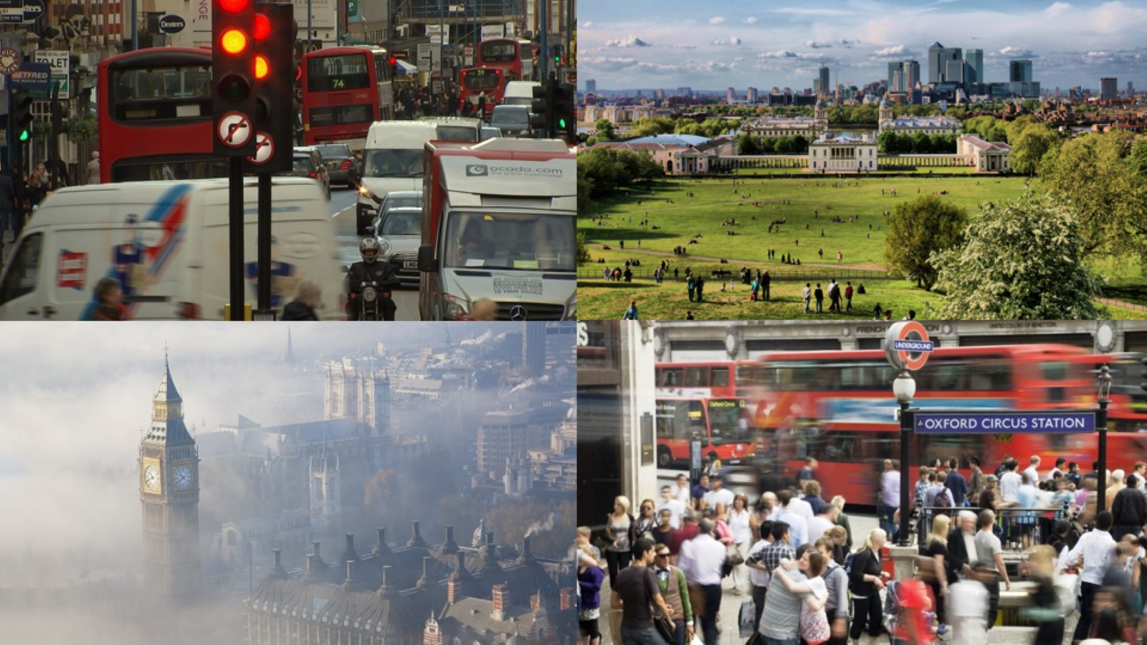

Slide 5
Rationale
Air quality affects well-being of residents and visitors of the city
9000 early deaths a year in London due to air pollution
Air pollution monitoring and mitigation are crucial for city councils
The use case is easy to understand and to follow

Slide 6
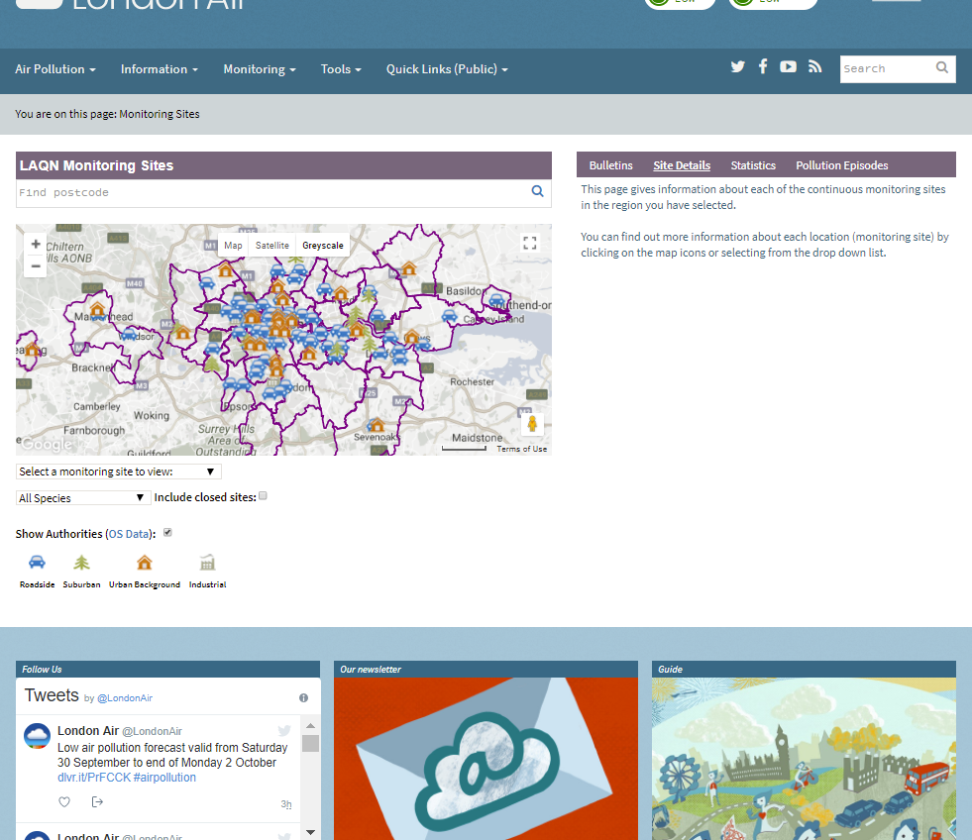
Data
Data is provided by Kings College London
Hourly sensor readings of air pollutants concentration
IoT data!

Slide 7

Aim
Use historical sensor readings to build a model for air pollution prediction and operationalize it using Pentaho platform

Slide 8
Machine Learning Orchestration Blueprint

Slide 9
Blueprint Overview
Enterprise struggle to put models to work – most of data science POCs never go into production
Bottlenecks in the workflow – from data preparation to updating models

Slide 10
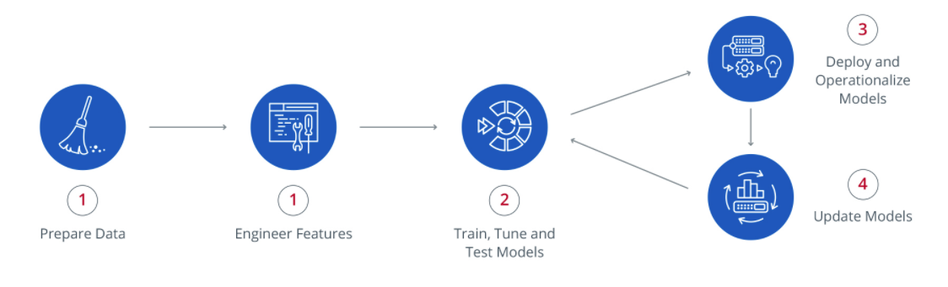
Machine Learning Orchestration 4 Key Areas
Pentaho platform remove bottlenecks in four key areas of machine learning workflow

Slide 11
Demo Components

Slide 12
List of Components
Data preparation and feature engineering workflow
Workflow for training a predictive model
Workflow for using the model for air quality prediction
Workflow for regular model update
Model scores assessment
Dashboards

Slide 13
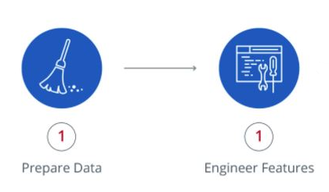
Data preparation and feature engineering
Implemented using Pentaho OOTB capabilities
Eliminating data quality issues: duplicate entries, missing values
Transforming data into features that make models work
LAQ_LSTM_train.kjb

Slide 14
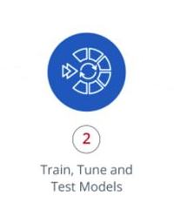
Workflow for model training
The model is trained on the historical data
Model weights are saved in JSON format
LAQ_LSTM_train.kjb

Slide 15

Using the model for air quality prediction
New data fetched from API every day
Pentaho job is scheduled to make predictions on new data every day
LAQ_LSTM_apply_on_new_data.kjb

Slide 16

Regular model update
As more data become available the model weights are updated
Pentaho job for model updated is scheduled to run regularly
Model score update is stored
LAQ_LSTM_update_the_model.kjb

Slide 17
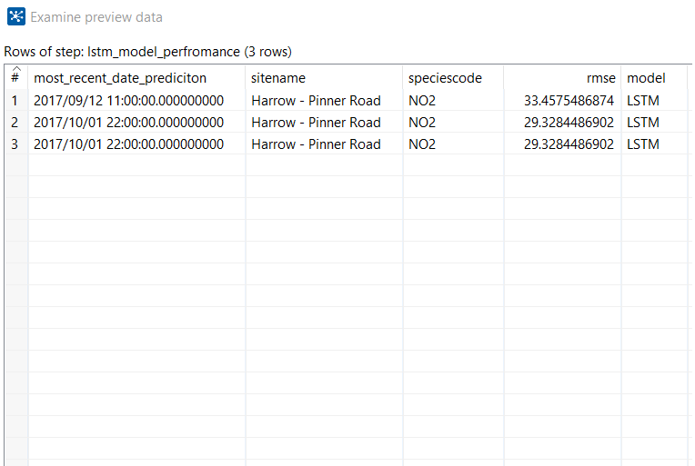
Model scores assessment
Model accuracy estimated on model training and update
RMSE metric evaluated when previous predictions are compared to data
Model scores are stored in DB

Slide 18
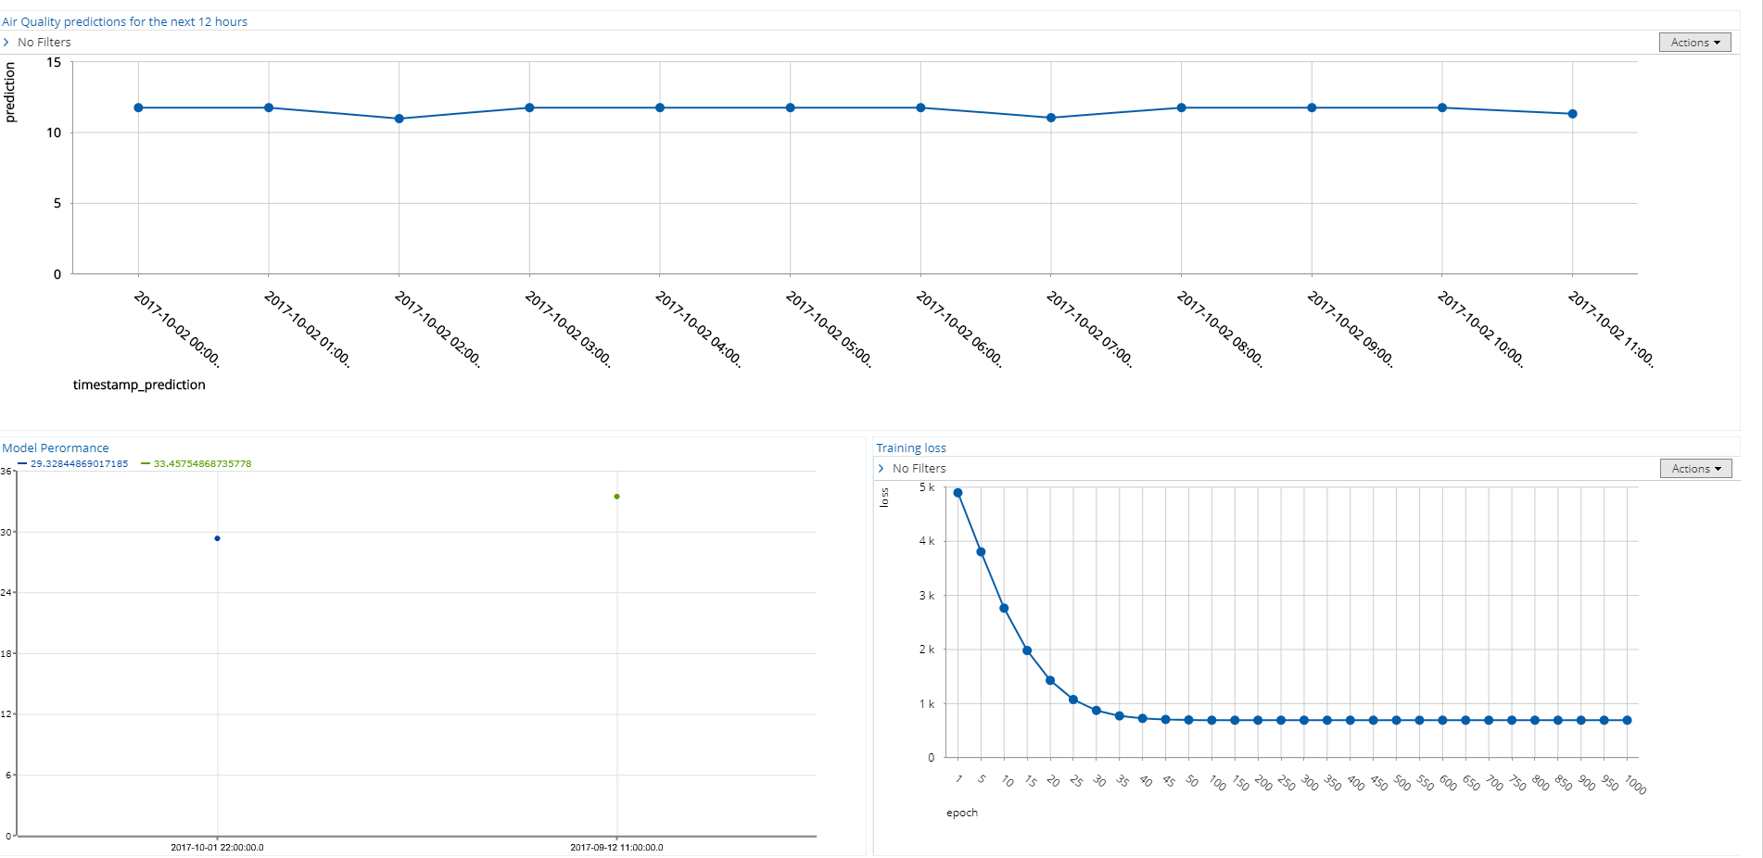
Dashboards
Current predictions
Loss curve for model training
Accuracy of previous predictions

Slide 19
Implemented Predictive Model

Slide 20


Long Short Term Memory (LSTM) network
Long short-term memory network is a recurrent neural network architecture that remembers values over arbitrary intervals
Trends
Seasonal patterns
Short-term variability

Slide 21
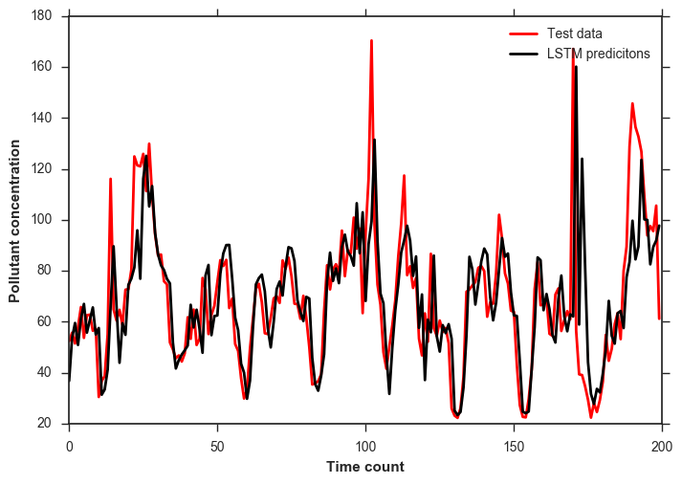
LSTM Configuration
4 lag features
12 hours ahead prediction
Great performance on test set

Slide 22
Summary

Slide 23
Summary
End-to-end workflow and machine learning orchestration were implemented on London Air Quality data
Deep learning model for time series prediction was embedded into Pentaho workflow
MLO blueprint
SUB POINT
Dashboards
SUB POINT
SUB POINT
Timeseries prediction
LAQ predictive
Deploy predictive models
Deep learning
SUB POINT
SUB POINT
IoT demo

Slide 24

Future Applications
Smart Cities opportunities
IoT/Sensor Data prediction
LSTM power!
Machine Learning Orchestration
Put models into production
General Predictive demos

Slide 25
Thank You

